Slide 1











2025-2026

Slide 2
https://www.youtube.com/watch?v=uMc1IpLKXd8

Slide 3
League President
Training

Slide 4

Introduction
This lesson is broken into six sections:
Organizing Leagues
Keep the League Rolling
Committees
Financial Responsibilities
Meetings
Season Wrap-Up

Slide 5
Organizing Leagues

Slide 6
League Governance
Leagues are governed by the board of directors.
The board of directors is comprised of the team captains and league officers.
Officer elections are conducted prior to prize disbursement unless the board of directors state they are to be held prior to the start of the league.
League officers must be USBC members.

Slide 7
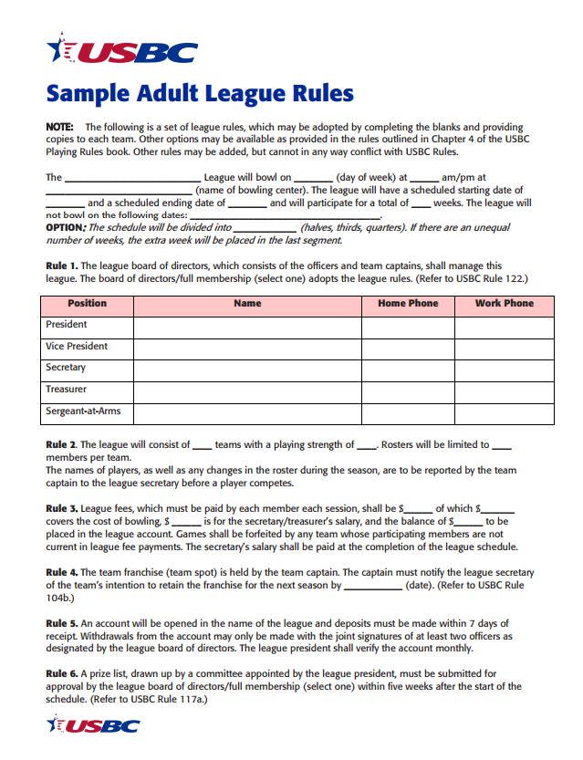
Organizational Meeting Basics
An organizational meeting is held to adopt rules, finalize rosters and make any other decisions necessary prior to the start of league competition.
Sample League rules can be found on the Rules page of BOWL.com

Slide 8
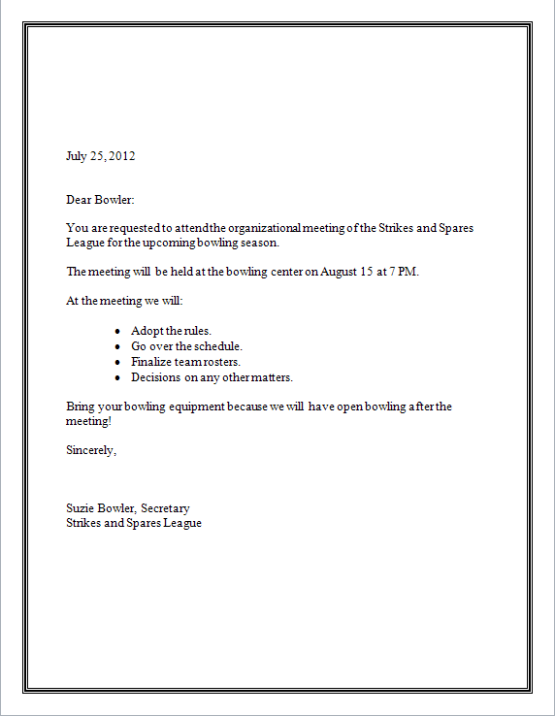
Organizational Meeting Basics
July 25, 2018
League rules are adopted by the board of directors unless league rules state the general membership.

Slide 9
Organizational Meeting
A quorum at the organizational meeting is established by those present.
Accurate meeting minutes should be kept.
Majority vote is needed to change an existing rule or to establish any new rules.
  Example - 25 people are in attendance, 24 votes are cast, 13 votes are needed to pass a motion

Slide 10
Organizational Meeting
USBC members receive:
A certified average
Tournament eligibility
Bonding of league prize fund
Standardized rules and equipment
Member Rewards

Slide 11
Organizational Meeting

Slide 12
League Bank Account
USBC Rule 102f, item 1 requires all leagues to have a bank account.
Work with the treasurer to open the account.
The account must be in the name of the league.
Must be opened at an insured recognized bank or credit union or with the center’s in-house banking service.
Monthly bank statements sent to president.

Slide 13
League Bank Account
Apply for an Employee Identification Number (EIN) through the IRS.
Complete Form SS-4
  Process electronically on irs.gov.

Slide 14
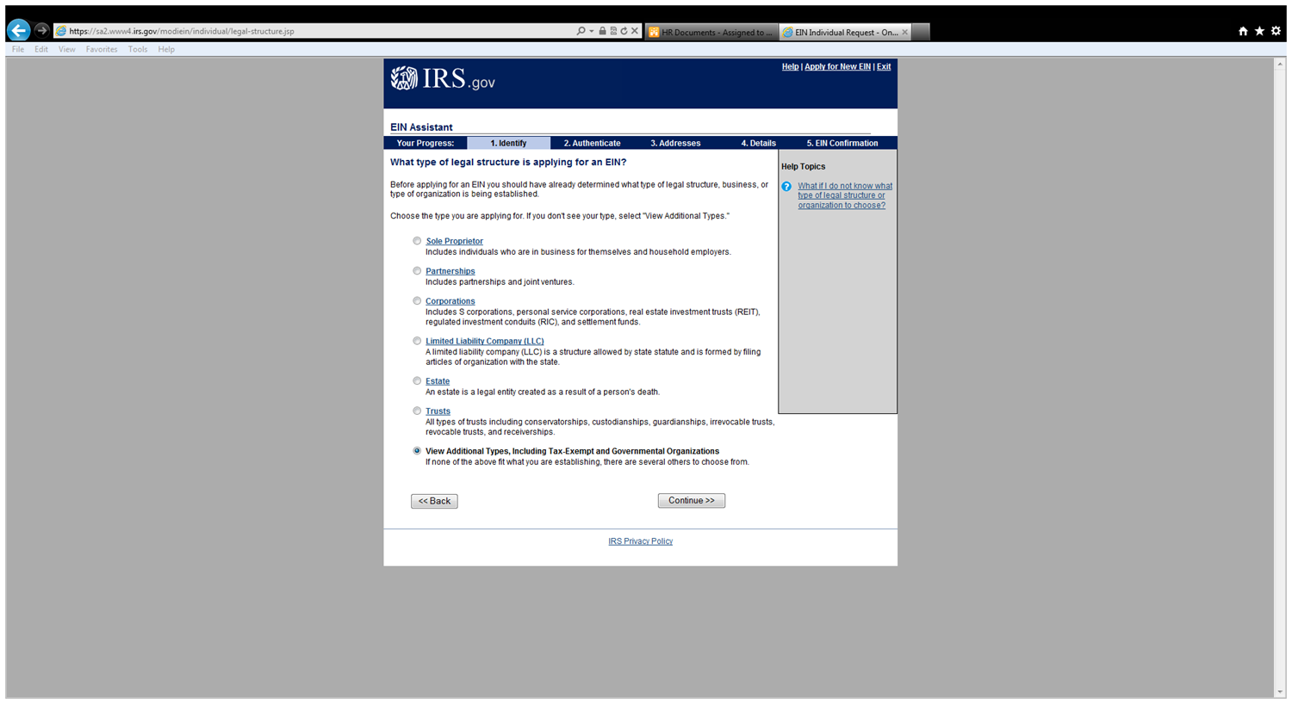
League Bank Account

Slide 15
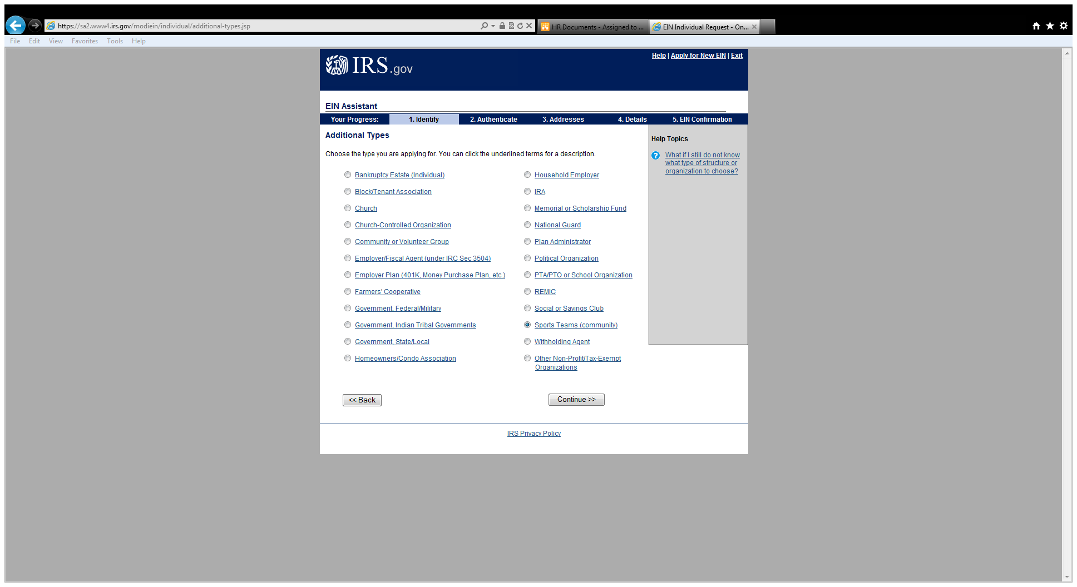
League Bank Account

Slide 16
League Startup
“Keep the League Rolling”

Slide 17
Hectic Week 1
It does not have to be this way!

Slide 18
Hectic Week 1
Arrive early to welcome new members.
Prior to starting, discuss the information that was distributed.
Inform captains of where you are bowling for any questions.

Slide 19
After Week 1
President should verify that all membership applications, dues and league application has been forwarded to the appropriate local association(s) within 30 days of the start of the league.
The league is temporarily certified for 30 days from the first day of the league.

Slide 20
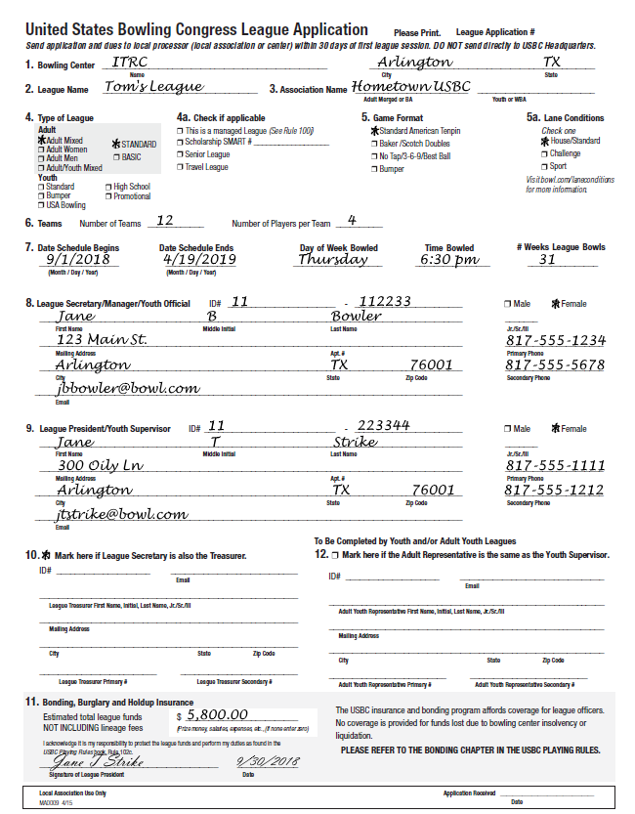
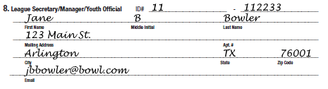

After Week 1
Make sure e-mail addresses for all officers are entered, accurate and current.
The league president must sign the application.

Slide 21
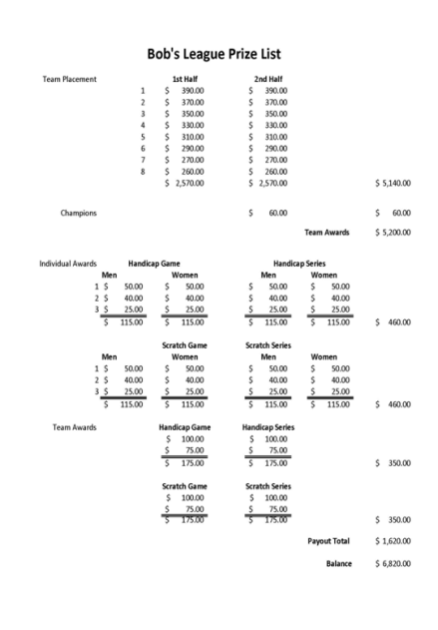
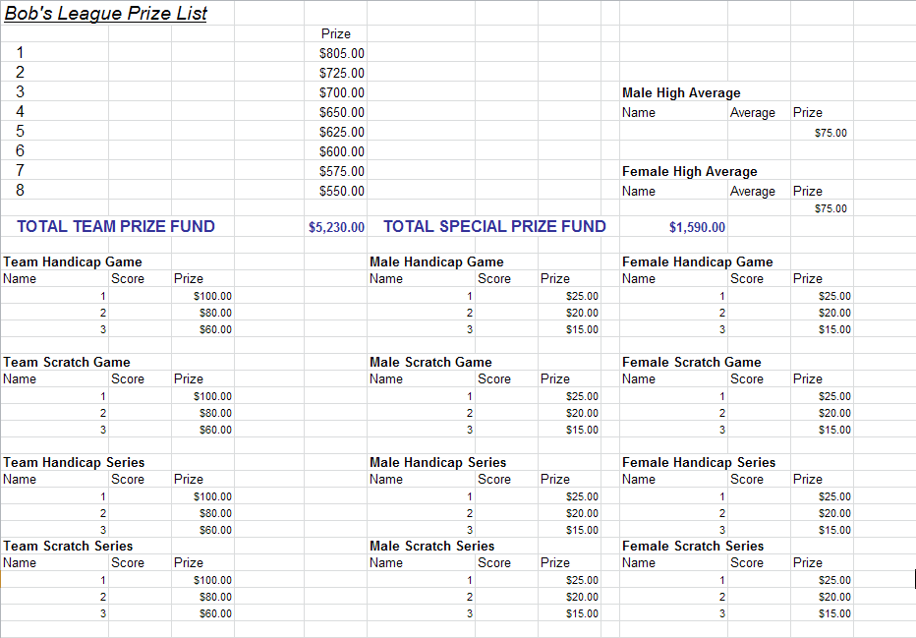
Prize List
Prize list A
Prize list must be presented by the fifth week.
President is responsible for appointing a prize committee.
Prize list B

Slide 22
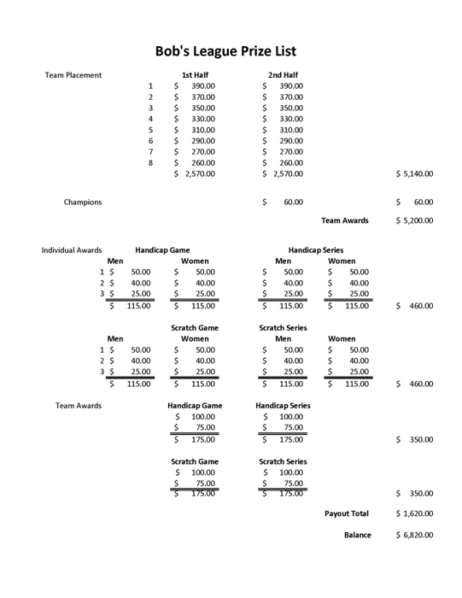
Prize List
Winning prize list must receive a majority of the votes cast.
Prize List A WINS!

Slide 23

Financial
Responsibilities

Slide 24


Weekly Responsibilities
The president should verify weekly that the treasurer is:
Collecting the appropriate league fees.
Making deposits within 7 days.
Paying any bills including lineage to the bowling center.

Slide 25
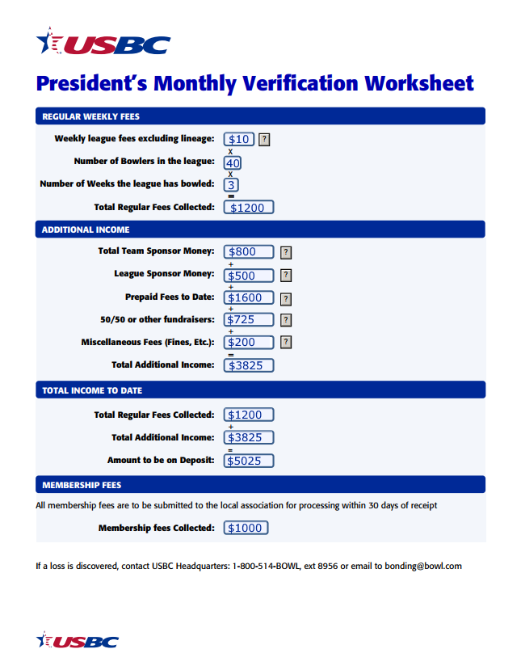
Monthly Verification
While the treasurer is responsible for properly handling the funds, it is the president’s responsibility to ensure the money is where it is supposed to be by verifying the account monthly.

Slide 26
Monthly Verification
When verifying take the following into consideration:
The center may only charge by actual number of bowlers.
Absentees and vacancies.
Bowlers may pay weekly or monthly.

Slide 27
Bonding, Burglary & Hold-up Insurance
USBC leagues are protected for up to $10,000 in misused funds provided bonding requirements are met.

Slide 28
Bonding, Burglary & Hold-up Insurance
Funds are also insured against loss by burglary or holdup by violence or the threat of violence.

Slide 29
Bonding, Burglary & Hold-up Insurance
USBC Burglary and Holdup insurance covers:
Deposits
One week’s receipts with a limit of $2000.
Withdrawals
Not to exceed $10,000 at any one time.

Slide 30
Signatories
Members of an immediate family include:
mothers, daughters, sisters, wives, husbands, sons, brothers, fathers, stepsisters, stepbrothers, stepmothers, stepfathers and in-laws.

Slide 31
League Account
Officers must:
Be a minimum of 18 years of age.
Be a member of USBC.
Not have been convicted of a felony.
Not have misused USBC funds in the past.

Slide 32
Committees

Slide 33

Committees
The president is responsible for appointing committees.
The Prize and Audit Committees are mandatory.

Slide 34
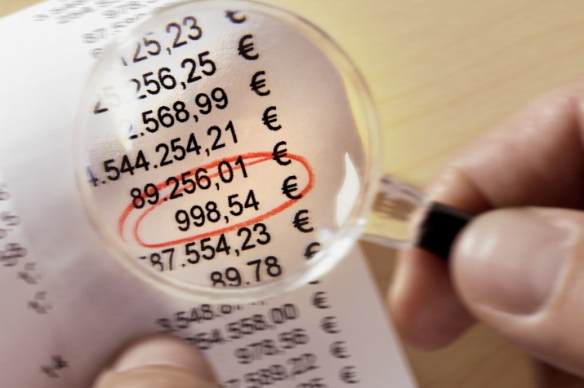
Audit Committee
The Audit Committee must perform at least one audit no earlier than one month prior to distribution.
Audit committee should:
Verify receipts and amount on deposit.
Review disbursements and ensure all checks have two signatures.
Audit committee procedures and worksheet can be found in the Rules section of BOWL.com.

Slide 35
Additional Committees
Additional Committees to consider:
Awards Committee
Banquet Committee
Nominating Committee
Postponement Committee

Slide 36
Meetings

Slide 37
Meeting Quorum
A Quorum Is:
Members present for a meeting prior to the start of the season.
For all other meetings a quorum is a majority of the voting body.
A majority is one more than half.
Example: The board of directors (captains & officers) total is 24. A quorum for a board meeting is 13.

Slide 38
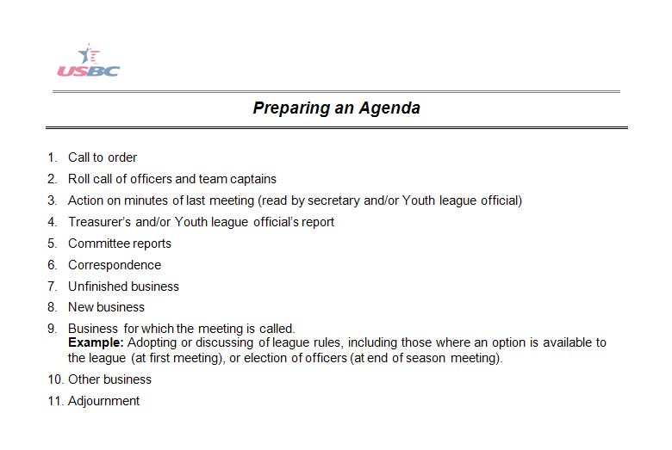
Meeting Agenda

Slide 39
Running a Meeting
Role
Minutes
Reports
Unfinished Business
New Business

Slide 40
Voting
A league has the following options once a motion is made and seconded. In taking the vote the league has the following options:
Voice vote.
Show of hands.
Ballot vote.

Slide 41

Common Meeting Types
Meetings are important to actively exchange ideas and accomplish goals.
In addition to the organizational and election meetings, here are some more common types of meetings:
Protested/Disputed Games
Nonpayment of league fees
Dismissal from office or league

Slide 42
Common Meeting Types
Protested/
Disputed Games
The board is authorized to make decisions when games are protested or disputed.
Board of Directors have 3 options when there are protested or disputed games:
Forfeit games bowled.
Null and Void games bowled.
Have games stand as bowled.
Nonpayment of league fees
Dismissal from office or league

Slide 43
Common Meeting Types
Protested/
Disputed Games
15 days
Or
72 hours
Nonpayment of league fees
Dismissal from office or league

Slide 44
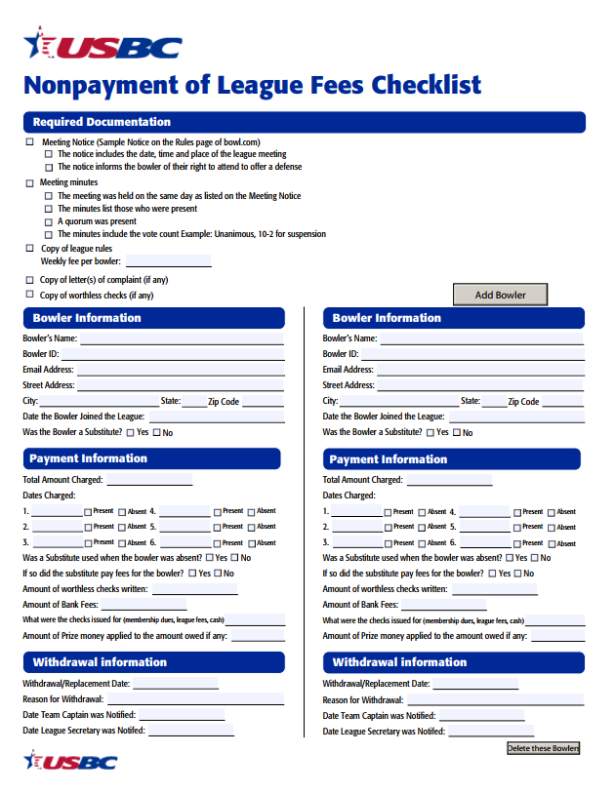
Common Meeting Types
Protested/
Disputed Games
The Nonpayment of League Fees checklist can be found on the Rules page of BOWL.com
Nonpayment of league fees
Dismissal from office or league

Slide 45
Common Meeting Types
Protested/
Disputed Games
A player may be dismissed from the league or an officer removed from league office for any of the following reasons:
Conduct derogatory to the best interest of the league.
Any deliberate action which can be proven to be detrimental to the best interest of the team.
Violation of any USBC or league rule.
Nonpayment of league fees
Dismissal from office or league

Slide 46
Season Wrap-up

Slide 47
Final League Meeting
A final league meeting is required to:
Distribute awards and prize money
Elect officers
Prizes must be paid within 21 days of the end of the league.

Slide 48
Elections

Slide 49
Elections
Each league must elect:
President
Vice President
Secretary
Treasurer
The league may also elect a Sergeant-at-arms.
All league officers must be a member of USBC.

Slide 50

Elections
Nominations are accepted from the floor, these do not require a second.

Slide 51
Elections
Officers are elected by majority vote.
Remember a majority is one more than half.
Absentee and proxy voting is prohibited.
The league president and candidates are entitled to vote.

Slide 52
Elections

Slide 53
Elections
Elections are finished and now it is time to hand out awards and payout the prize fund.

Slide 54

Wrap-up
Lastly verify the secretary has submitted year end averages and pay the league salaries.

Slide 55
Congratulations!
You’re Done!

Slide 56
OFFICER DUTIES
1. Fill in for the president when not available.
2. See info under President (above) for more information about the president’s duties.
VICE PRESIDENT
ALL INFORMATION CAN BE FOUND AT
BOWL.com | ARC-League Resources

Slide 57
League Secretary Training

Slide 58
Introduction
This lesson is broken into six sections:
Meetings
The Organizational Meeting
Week One
League Certification
Weekly Duties
Season Wrap-up

Slide 59
Meetings

Slide 60
Meeting Notification
As league secretary, you will be responsible for notifying the appropriate league members of the date, time and place.

Slide 61
Quorum Definition
A quorum is the minimum number of members required to hold an official meeting.
At a meeting during the season, a quorum is a majority or one more than half.
At the organizational meeting a quorum is those present.

Slide 62

Determining a Quorum
We have a quorum?
Here!
Here!
Here!

Slide 63
Meeting Minutes
Minutes should include:
  Roster of those present and absent
  Any motions made
  Who made the motion
  Who seconded the motion
  Final outcome of any votes taken
  Brief summary
Minutes do NOT need to be verbatim

Slide 64
The Organizational Meeting

Slide 65
The Organizational Meeting
The league adopts its rules, finalizes rosters and makes decisions on any other matter which needs to be addressed before the league begins.

Slide 66
Adopting Rules
The board of directors, which consists of the team captains and league officers, are responsible for the adoption of rules unless the league rules specify the general membership adopts the rules.

Slide 67
USBC Benefits
USBC members receive:
A certified average
Tournament eligibility
Bonding of league prize fund
Standardized rules and equipment
Member Rewards

Slide 68
Finalizing Rosters
Go over the team rosters with each captain and note any vacancy a team may have.
Strikes & Spares
Vick Johnson
Torry Smith
Terri Jones
Joe Bowler
Steve Wonder
Kate Middle

Slide 69
Updating League Rules
For the league rules:
Update based on league decisions
Have President check rules
Make copies to pass out to league officers and team captains

Slide 70
WEEK ONE

Slide 71
It doesn’t have to be this way!

Slide 72
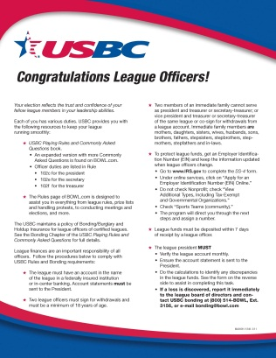

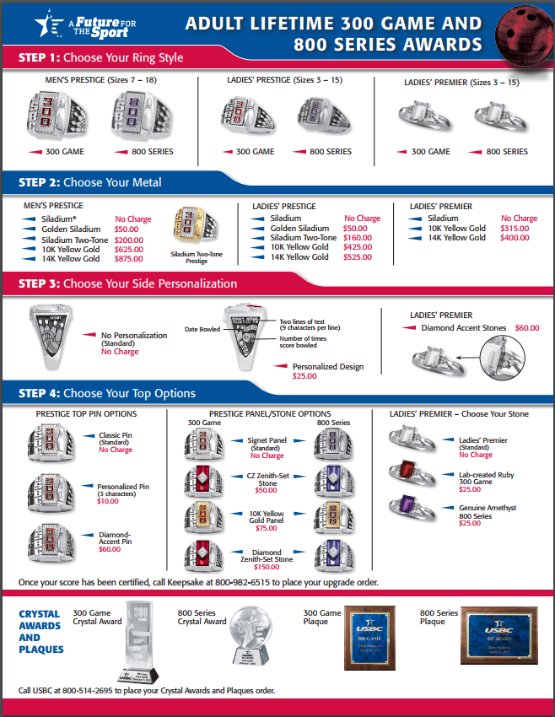
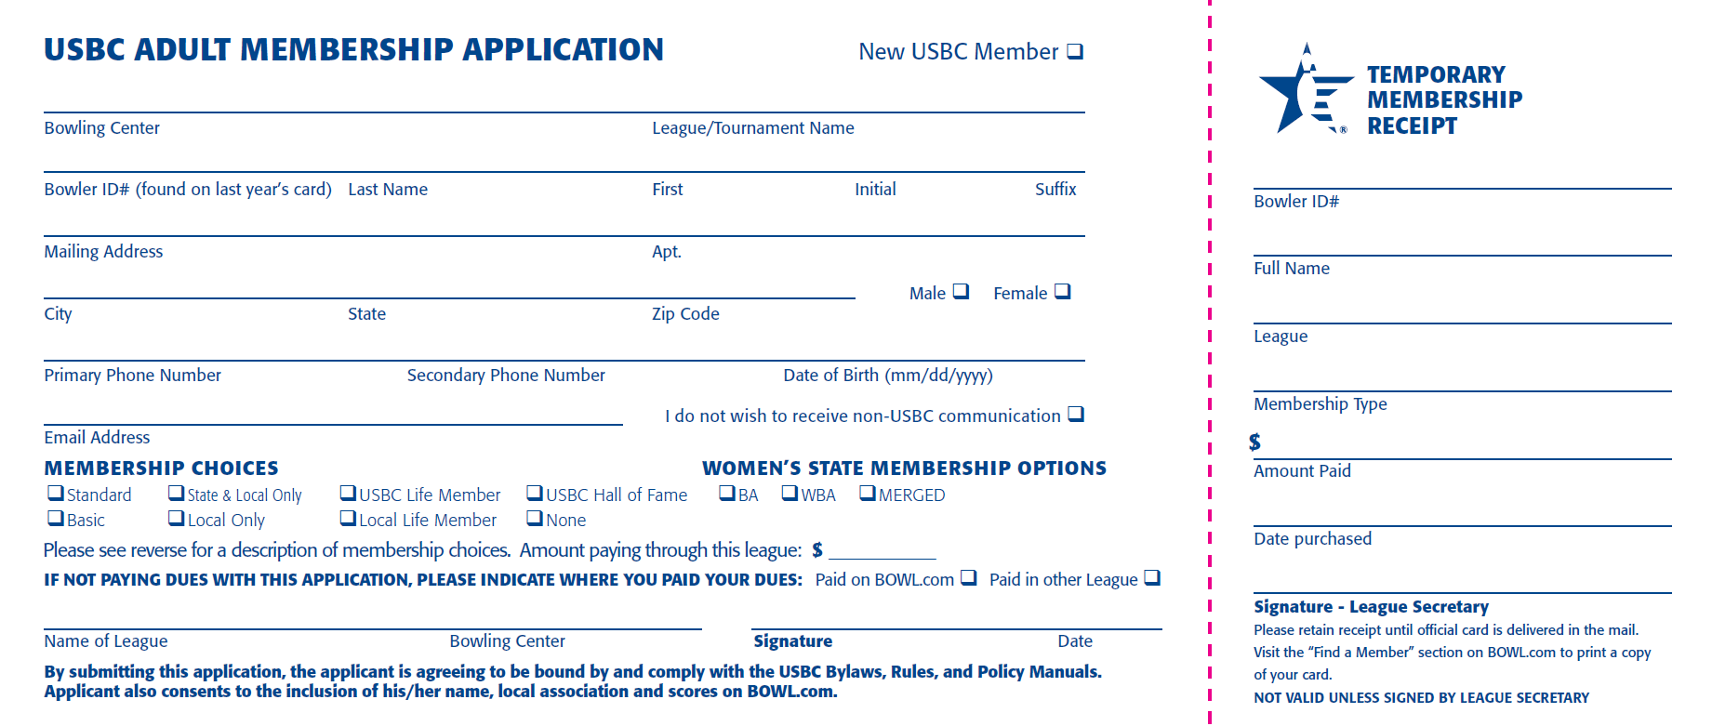
League Membership Package

Slide 73
Come Prepared
Your hand-out for each team should include:
League rules
Organizational Meeting minutes
Membership Applications

Slide 74
Assigning Team Numbers
If no rule has been adopted, assign numbers:
Based on finish position from previous season
By team names drawn from a hat
Based off previous season’s team number
In order as they get to the first night of league

Slide 75
League Night Responsibilities
Get there early
Set hand-outs on lanes
Greet teams as they come in
Introduce yourself to new members
Inform team captains what you handed out and where you are bowling

Slide 76
USBC Membership
USBC Rule 101 states:
  To be eligible to bowl in a USBC league, a bowler must:
  Complete an individual membership application in each league the bowler participates in.
  Pay or show proof of payment of USBC dues and the required association membership fees in effect for the current season before:
    Adult membership: Completion of the bowler’s first series.
    Youth membership: The bowler’s third session of competition.
  Any team using a player who has not satisfied USBC membership eligibility requirements subjects the games in which the bowler participated to forfeiture.

Slide 77
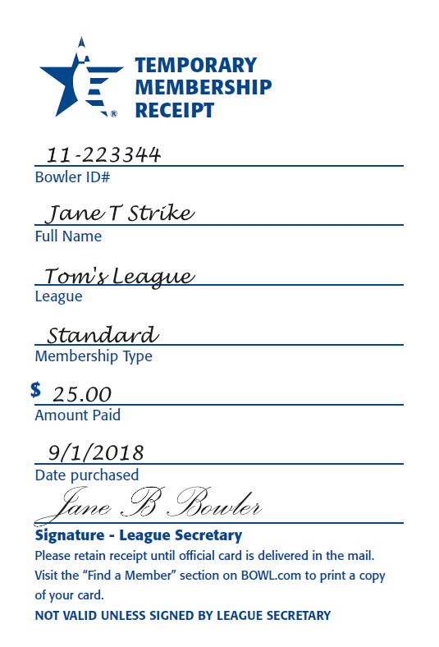
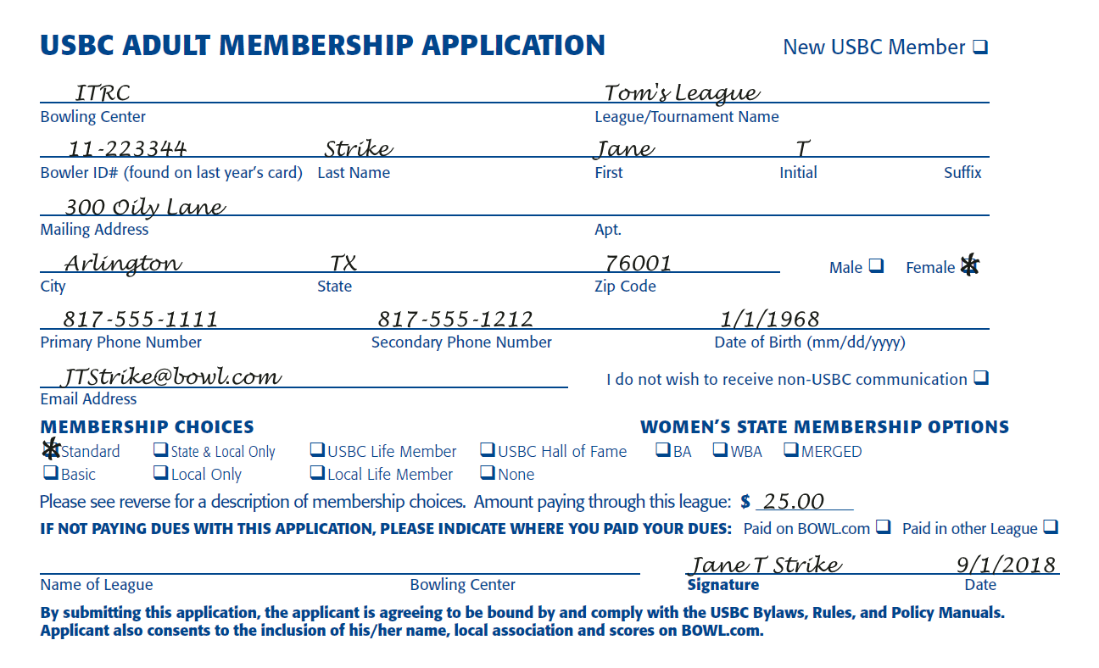
Membership Receipt

Slide 78
League Certification

Slide 79
Temporary Certification
Each USBC league is:
Temporarily certified for 30 days counting the first day of competition
Eligible for all membership services while temporarily certified

Slide 80
Certification Form
To insure there is no delay in certification of the league, make sure the league application is filled out entirely and correctly.

Slide 81
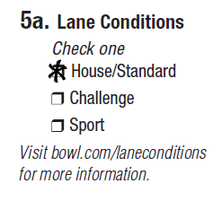
Lane Conditions

Slide 82


Schedule
One common mistake is secretaries not including the playoffs or any special contest as part of the schedule.

Slide 83
Officers
Make sure e-mail addresses for all officers are entered, accurate and current.

Slide 84

Bonding
Bonding amount includes total amount collected for the season for the prize fund, any salaries paid out and any expenses the league pays.

Slide 85
Signing the Application
The league president must sign the application.

Slide 86

Submission of Applications
30
Days

Slide 87
Weekly Duties

Slide 88
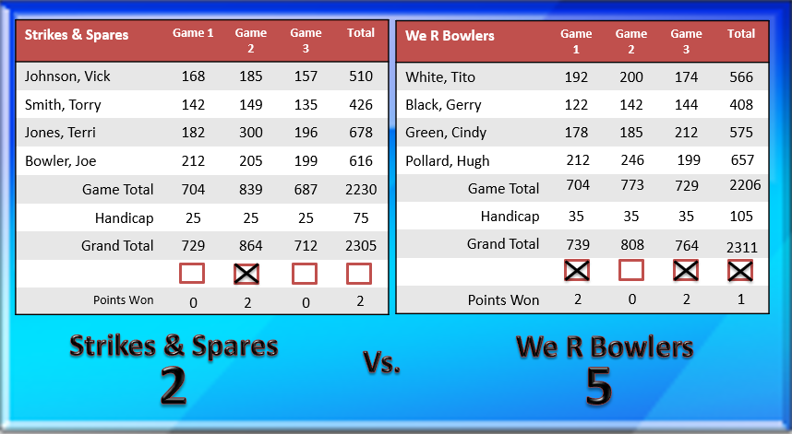
Entering Scores

Slide 89

USBC Awards

Slide 90
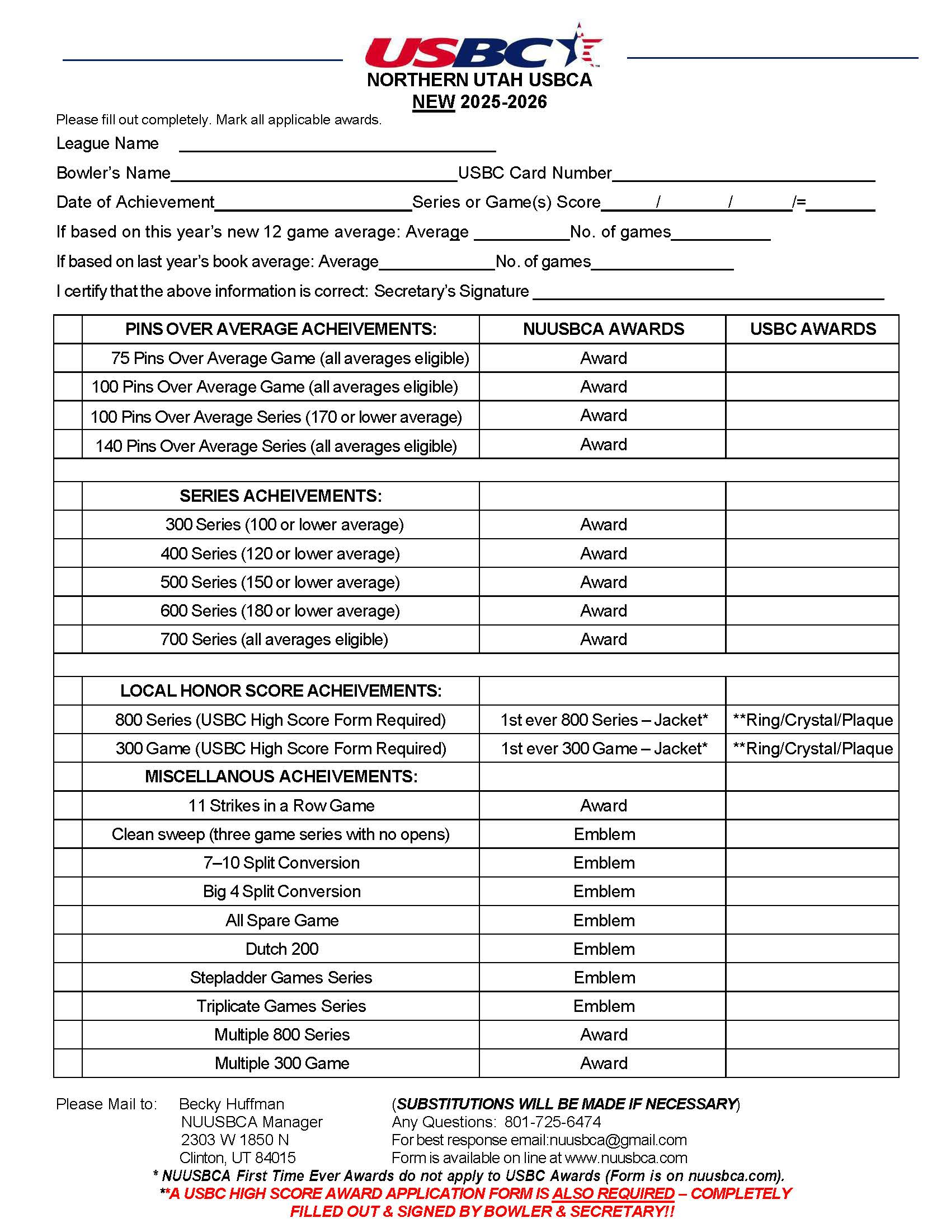
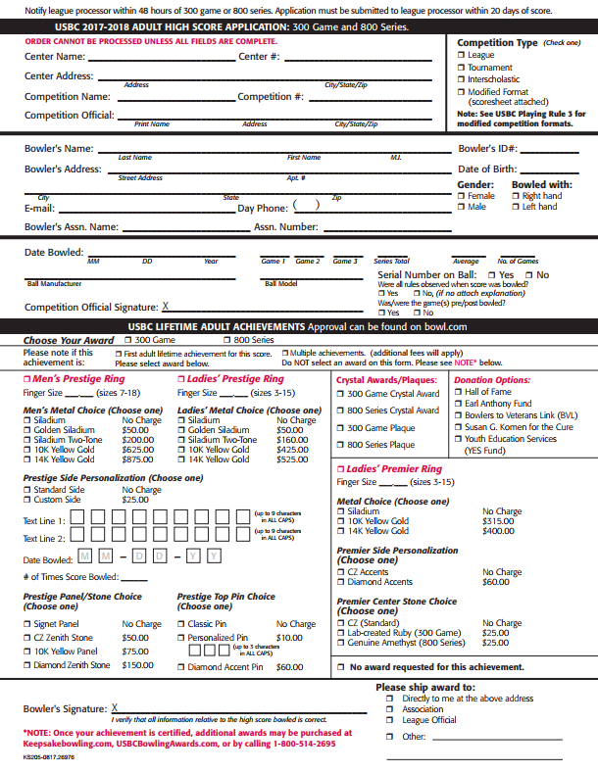
Award Applications

Slide 91
High Score Application
Ring Choice
Personalization
Bowler’s Signature

Slide 92
SUBMIT APPLICATION WITHIN 20 DAYS

Slide 93
Each Week
Come early
Have hand-outs on the lanes consisting of:
  Standing Sheet
  League record book or recap
Recognize award recipients
Have any new bowler fill out membership application

Slide 94
League Prize List
Must be presented for adoption by fifth week
  President responsible to see this is done
  Prize Committee presents options to board
Secretary distributes approved prize list
Prize list must receive majority vote
  If three or more are presented and no majority vote after first vote, prize list with lowest votes is thrown out

Slide 95
Weekly Routine
Enter scores into software
Calculate and distribute standings
Calculate averages
Apply for awards
Present awards
Answer questions from the bowlers

Slide 96
Season
Wrap-up

Slide 97

Year-end Meeting
Leagues have one final meeting to distribute prizes and elect new officers.

Slide 98

Final Standings
In order for the league members to be paid their prize money, you will need to print out one last standing sheet for the League Treasurer.

Slide 99
Officer Elections
Elections shall be held before the distribution of the prize fund unless the league rules state otherwise.
All league officers must be a member of USBC.

Slide 100
Final Averages
Submit averages of all bowlers regardless of the number of games, including substitutes to the local association.

Slide 101
Local Association Meetings
Notify league members of the date, time and place of any local association membership meeting.
Annual Meeting:
Saturday, April 4, 2026
10:00 am

Slide 102
League Records
Rule 102e, item 8 requires all league property to be turned over to the newly elected secretary.

Slide 103
Congratulations!

Slide 104
League Treasurer
Training

Slide 105
Introduction
This lesson is broken into five sections:
Getting Ready for Leagues
Weekly Duties
Financial Responsibilities
Bonding, Burglary & Holdup Insurance
Season Wrap-up

Slide 106
Getting Ready for Leagues

Slide 107
League Bank Account
USBC Rule 102f, item 1 requires all leagues to have a bank account.
Work with the president to open the account.
The account must be in the name of the league.
Must be opened at an insured recognized bank or credit union or with the center’s in-house banking service.
Monthly bank statements sent to president.

Slide 108
Employee Identification Number
Apply for an Employee Identification Number (EIN) through the IRS.
Complete Form SS-4
Process electronically on irs.gov.

Slide 109
SS-4 Form

Slide 110
SS-4 Form (cont.)

Slide 111
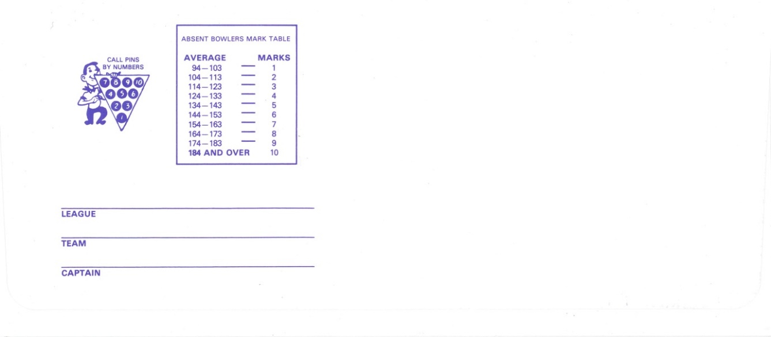
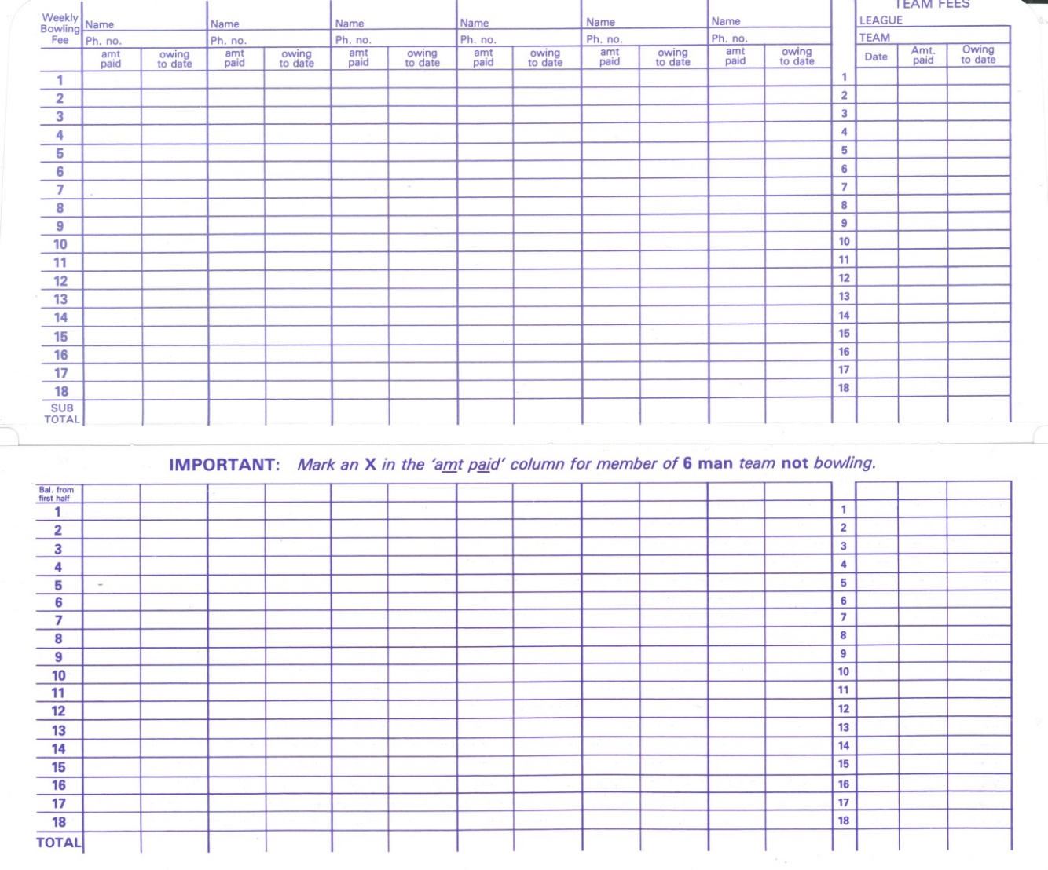
Payment Envelopes
Bob’s League
Strikes & Spares
Joe Bowler
Joe Bowler
Vick Johnson
Terri Smith
Torry Jones

Slide 112
Weekly Duties

Slide 113
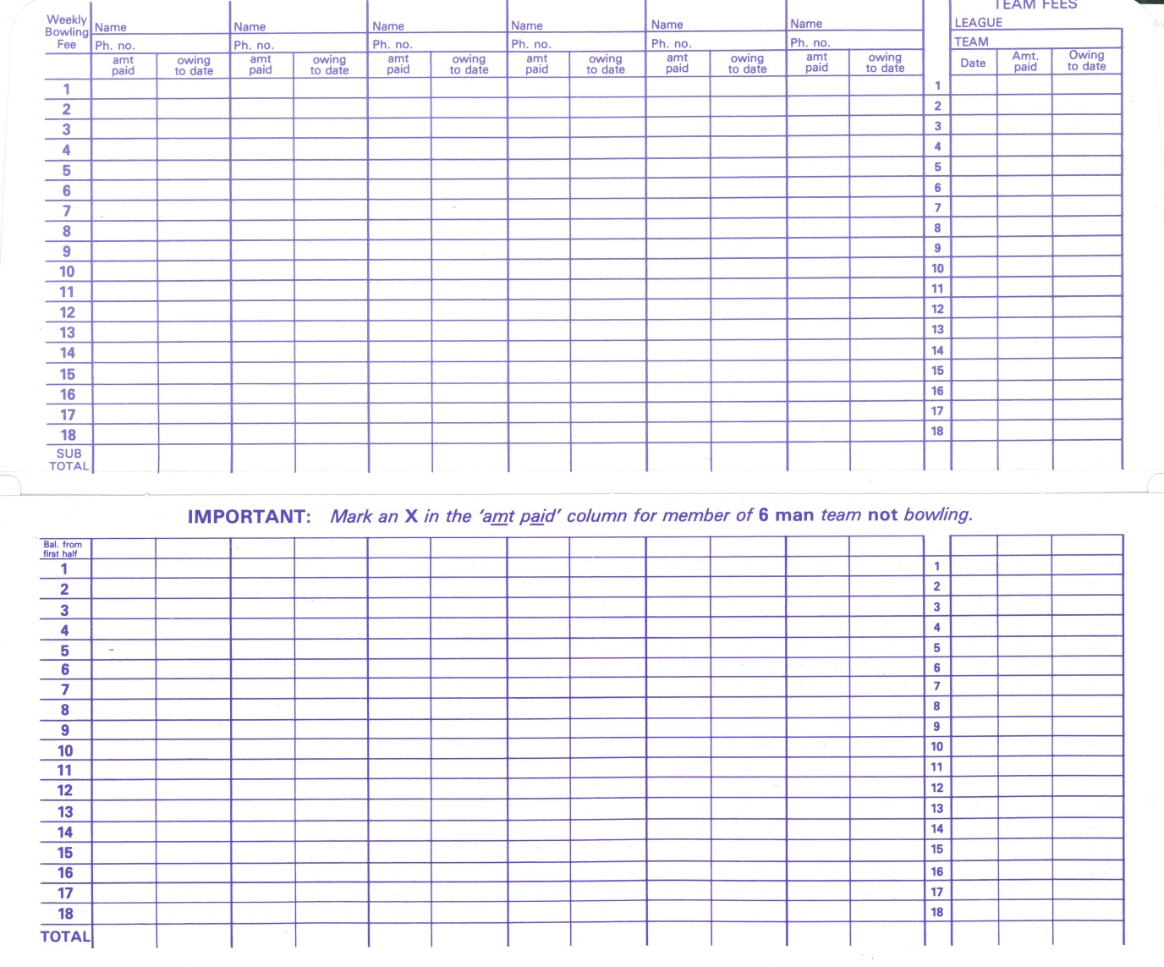
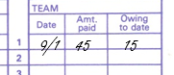
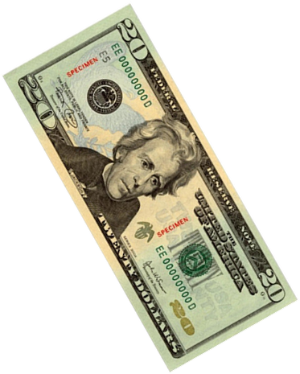
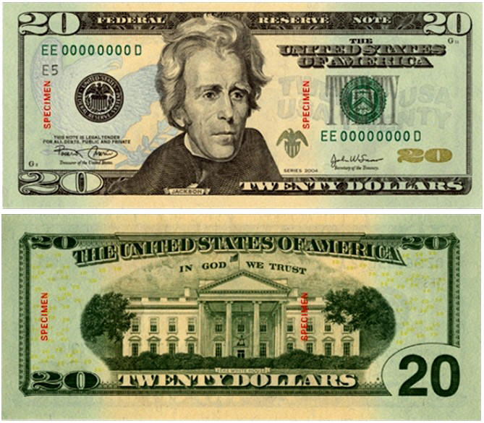
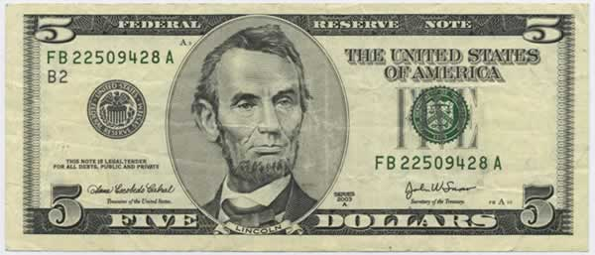
Verify Payments
Joe Bowler
Vick Johnson
Terri Smith
Torry Jones
15
0
15
0
0
15
15
0
9/1
45
15

Slide 114
Keeping Accurate Records
Reconcile envelopes regularly.
Inform team captain of any arrearages.
Report arrearages above what league rules allow to president.

Slide 115
Paying the Center
Checking Account
Introduction
How payment is made depends upon what type of account is set up.
Savings Account
In-House Banking

Slide 116
Paying the Center
Checking Account
Checking Account
Write a check to the center for lineage.
Checks must have signature of two authorized officers.
Prepare a deposit for the bank.
Deposits must be made within seven days.
Savings Account
In-House Banking

Slide 117
Paying the Center
Checking Account
Savings Account
Pay lineage with money received in the envelopes.
Make sure pay envelopes have been updated with amounts.
Take remaining amount home for deposit into account.
Deposits must be made within seven days.
Savings Account
In-House Banking

Slide 118
Paying the Center
Checking Account
In-House Banking
Count all money from envelopes and deposit with center.
Savings Account
In-House Banking

Slide 119
Other Bills
The treasurer also pays any other bills the league may have, which include:
  Banquet costs
  Trophies
  Salaries
  Membership Dues

Slide 120
Membership Dues
Membership dues are paid directly to the association. Work with the league secretary to determine how much is needed.
30
Days

Slide 121
Membership Dues
Pay for memberships with a league or cashier’s check or with a money order.
NEVER PAY BY CASH!

Slide 122
Financial
Responsibilities

Slide 123
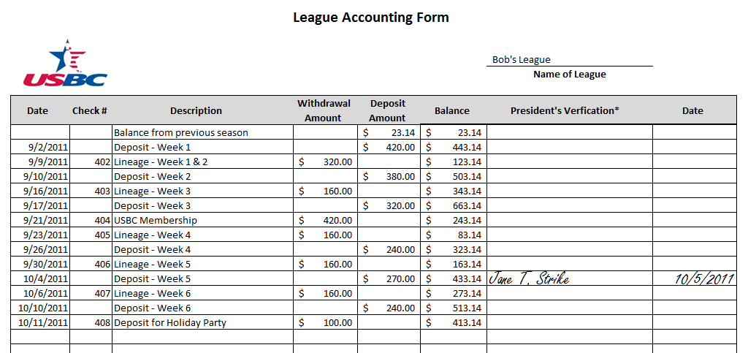
Officer Duties
102f. Duties of the Treasurer
The treasurer shall perform the following duties:
Arrange to have all league funds deposited within one week of receipt.
102c. Duties of the President
The president/league supervisor shall perform the following duties:
Personally verify the league’s bank balance monthly.

Slide 124
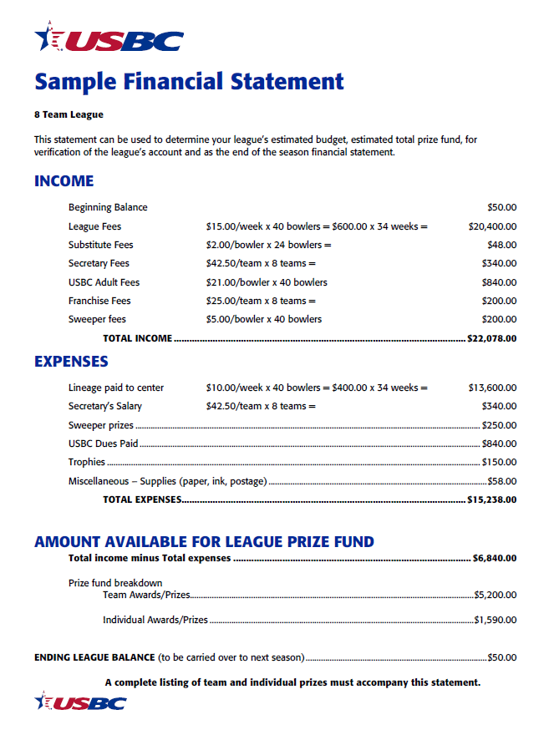
Mid-season Financial Statement
102f. Duties of the Treasurer
The treasurer shall perform the following duties:
Be responsible for a complete accounting of all receipts and disbursements. On the request of the president or board, furnish a current financial statement to each team captain.

Slide 125
Come Prepared
To calculate the prize fund, you multiply:
number of teams 8
X number of players per team 5
X number of weeks 34
X amount of prize money each pays $5.00
$6800

Slide 126
Additional Income & Expenses
Income
Beginning Balance $50
League Prize Fund $6800
Franchise Fee = $25.00 X 8 $200
Expenses
Trophies $150
Supplies (Paper, ink, postage) $58
Estimated Prize Fund $6840

Slide 127
Audit Committee
The Audit Committee
Is appointed by the president.
Ensures the league’s funds have been deposited and disbursed as directed.
Ensures the records have been accurately and completely kept.
Ensures expenses have been paid.
At least one audit must be done no more than a month prior to disbursement of the league’s prize money. USBC recommends an audit be done quarterly.

Slide 128
Performing an Audit
Information the Audit Committee needs include:
Lineage receipts showing number of bowlers paid each week
League Rules
Account Statements
Other receipts for expenses paid
Team pay envelopes
Treasurer must be available to answer any questions the committee may have.

Slide 129
Bonding, Burglary & Holdup Insurance

Slide 130
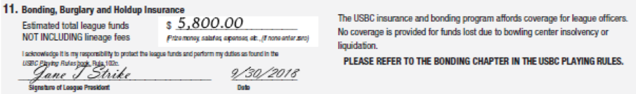
Bonding Policy
USBC leagues are automatically protected against $10,000 in misused funds. If prizes/awards are going to exceed this amount, list total prize fund amount on league application.

Slide 131
Burglary & Holdup
Loss of funds due to burglary or holdup are covered when funds are taken:
By violence or threat of violence
Through forcible entry where funds are kept. There must be visible evidence of forcible entry.

Slide 132
Coverage Limits
Deposits
One week’s receipts with a limit of $2000.
Withdrawals
Not to exceed $10,000 at any one time.

Slide 133
Eligibility Requirements
To be bondable, a treasurer must:
Be a minimum of 18 years of age.
Be a member of USBC.
Not have been convicted of a felony.
Not have misused USBC funds in the past.

Slide 134
Common Mistakes
Counting Money
Introduction
Safeguarding the league’s money is job #1.
Don’t make the same mistakes others have which caused prize funds to not be covered.
Money Unattended
Left in Vehicle
$10,000 Limit

Slide 135
Common Mistakes
Counting Money
Counting Money
Money left on a table where it can easily be taken will not be covered.
Money Unattended
Left in Vehicle
$10,000 Limit

Slide 136
Common Mistakes
Counting Money
Money Unattended
Without violence or threat of violence, money left unattended will not be covered.
Money Unattended
Left in Vehicle
$10,000 Limit

Slide 137
Common Mistakes
Counting Money
Left in Vehicle
Vehicle must show signs of forcible entry in order for the funds to be covered. A police report is also required.
Money Unattended
Left in Vehicle
$10,000 Limit

Slide 138
Common Mistakes
Counting Money
$10,000 Limit
Do not withdraw more than $10,000 at any one time for disbursement.
Money Unattended
Left in Vehicle
$10,000 Limit

Slide 139
Season
Wrap-up

Slide 140
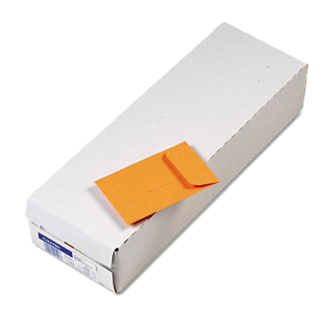


Time to Distribute

Slide 141

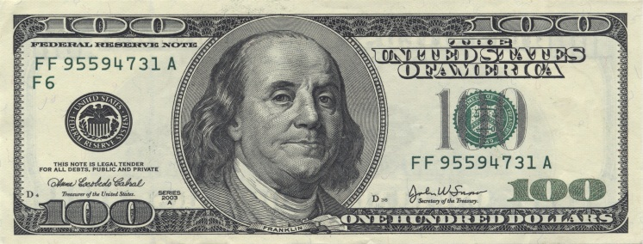
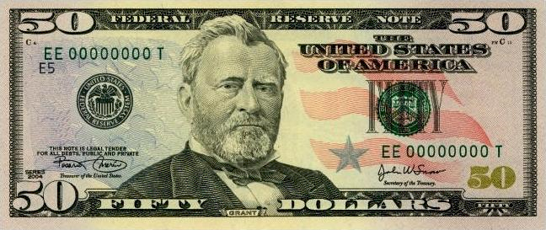
Sort Money
First Half $370
Second Half $350
Total $720
Roger That

Slide 142
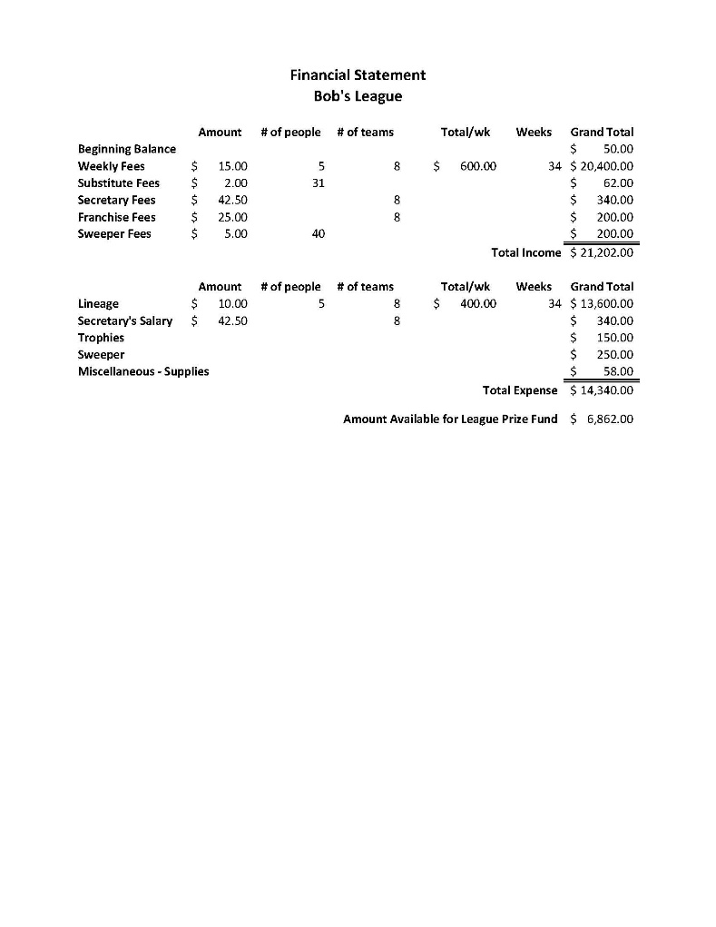
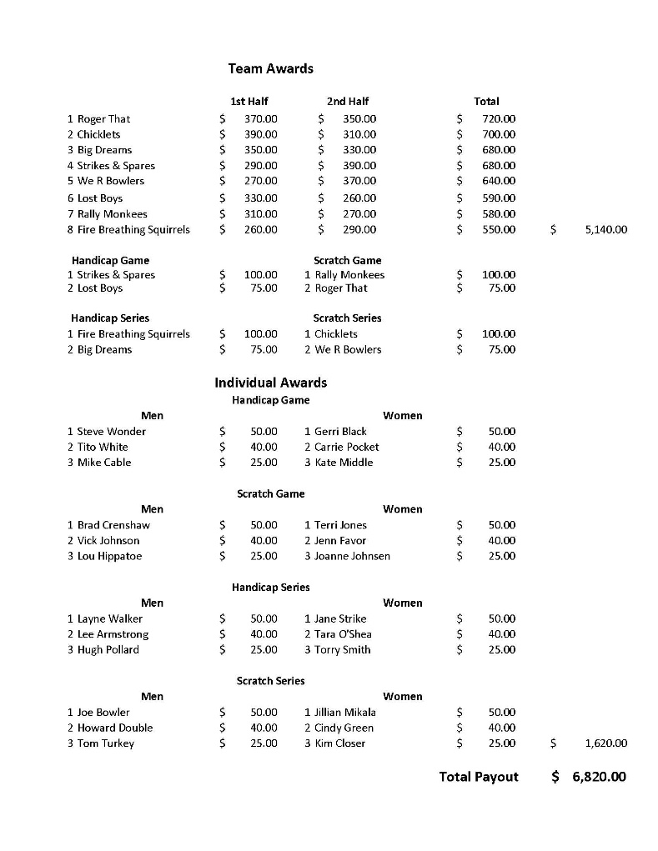
Year-end Financial Statement
Income Received
Prizes distributed and to who
Accounting of expenses

Slide 143
Rule 102f, Item 4
Distribute all prizes within 21 days after the end of the league schedule unless:
  The board has set another time for distributing prizes, or
  USBC has authorized holding up payment pending settlement of a claim or protest affecting the prize distribution.

Slide 144
Prize Distribution
USBC Suggests:
Individual Game/Series Awards
Team Game/Series Awards
Team placements money

Slide 145
Rule 102f, Item 7
All financial records, whether in possession of the former officer or newly-elected officer, shall be retained for at least one year form the completion of the season.

Slide 146
Memberships
Standard Membership: Aug. 1, 2025 - July 31, 2026
$ 9.00 LOCAL DUES (Same as last year)
$ 2.00 STATE DUES (Same as last year)
$15.00 NATIONAL DUES
$26.00 TOTAL
Basic Membership (16 weeks):
  $ 3.00 LOCAL DUES
  $ 7.00 NATIONAL DUES
  $10.00 TOTAL
**ALL BOWLERS CAN BUY CARDS ONLINE THROUGH BOWL.COM

Slide 147
INCLUDED IN YOUR PACKET
League Quick-Start Checklist
USBC League Cards – named and blank
League Dues Worksheet
League Sanction Application
USBC/Local Awards Form: New Criteria
Tournaments Schedule: Please announce at each league session.
Ice Breaker Tournament Flyer
Yard Sale Fundraiser Flyer
Awards word/adobe doc
USBC Rulebook
NUUSBCA Yearbook
CDE/BLS software NEW awards to import
AVAILABLE ON THE WEBSITE: FORMS

Slide 148
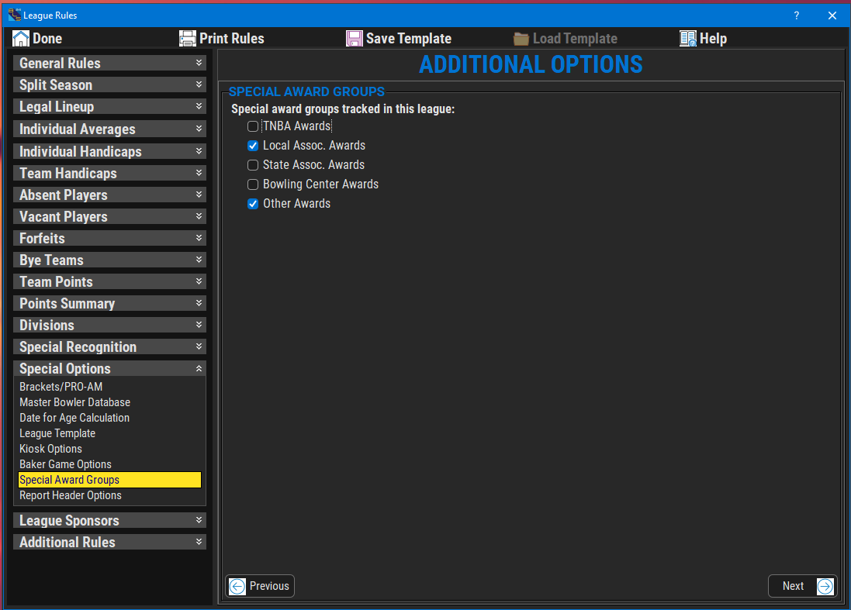
Turn off TNBAAwards
Adult Awards Set Up
Unclick TNBA BOX.
Only check the Local Assoc.

Slide 149
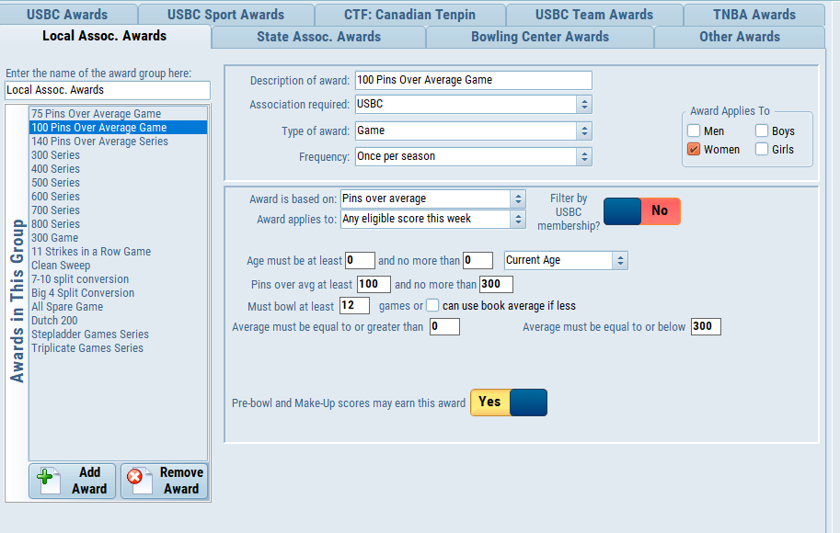
CDE Software
Awards
Setup
Go to nuusbca.com
Go to Forms Tab
Scroll down to League Officer information
Click on Adult awards BLS 2025.Awards
  YOUTH awards BLS 2025.Awards
Open BLS program
Click on Options
Local Awards Setup
Click on Local Assoc. Awards Tab
Utilities – Import Awards List
List will be under Downloads

Slide 150
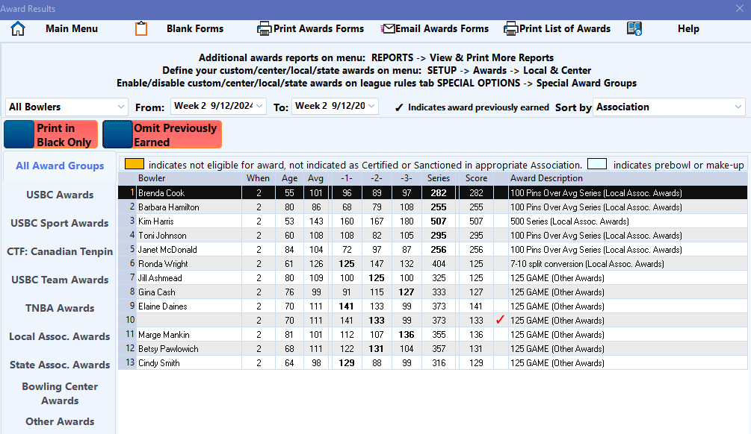
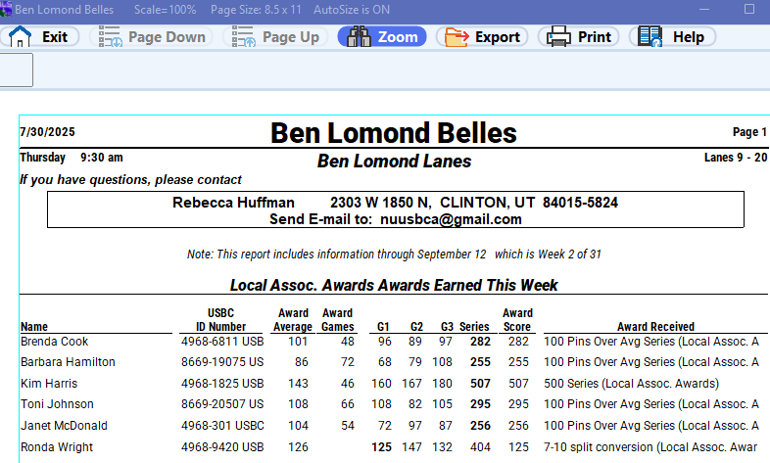
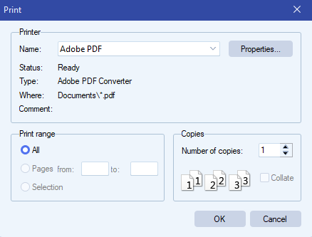
Email PDF Award Forms
1. Change printer to ADOBE PDF
or Microsoft PDF
2. Save to File
3. Email to nuusbca@gmail.com

Slide 151
RULES QUIZ
1 - Can we modify our Open Championship tournament and offer optional Women’s Divisions for a separate entry fee and use their Open Championship scores to determine our association Women’s Champions?
  Yes
  No
Answer: 2 – No – To take scores from one certified competition for use in another certified competition would be using a Mail-O Graphic format which is not available for use in place actual scores bowled for an association championship tournament.
2 - Which events are we required to offer in our association championship tournament? (Check all that apply)
1. Team
2. Doubles
3. Singles
4. 2 & 3
5. All of the above
6. Any of the above
Answer: 6 – Any of or any combination of the 3 events (team, doubles, or singles) can be offered for an association championship tournament

Slide 152
RULES QUIZ
3 - Which averages are acceptable for use in our association championship tournament? (Check all that apply) 1. Current season averages of 19 or more games 2. Composite averages for the past 3 years in our association 3. Averages of a minimum of 21 games established in leagues in other associations 4. Averages from non-USBC certified leagues within our jurisdiction 5. An individual’s average from our previous association championship tournament of at least 18 games.
1. Current season averages of 19 or more games
2. Composite averages for the past 3 years in our association
3. Averages of a minimum of 21 games established in leagues in other associations
4. Averages from non-USBC certified leagues within our jurisdiction
5. An individual’s average from our previous association championship tournament of at least 18 games.
Answer: 1, 2, 3 & 5 – Rule 319a states that averages from non-certified leagues cannot be used for entry purposes in USBC certified competitions

Slide 153
RULES QUIZ
4 - Julia had an injury this season which required her to switch to the opposite hand. She asks if she can use her left-handed average for your tournament and you authorize it. As the squad hits the lanes, you realize that you forgot to ask Julia if she had applied for average relief under Rule 4e. When asked, Julia states she knows nothing about this rule. What do you do?
(Check all that apply)
  1. Leave her left-handed average in and hope no one protests.
  2. Tell Julia to apply for average relief on Monday and if it is granted, you will let her use that average for this tournament.
  3. Tell Julia she will have to use her last season’s right-handed average for this tournament.
  4. Advise Julia that she is going to be disqualified for submitting an incorrect average and if she leaves quietly, security will not be called.
  Answer: 3 – If an individual has not applied for, and been granted average relief under Rule 4e, the player is to use their highest average regardless of which hand is being used during the tournament.

Slide 154

3rd Annual BVL Fundraiser
November 23, 2025
9am – 11am – 1pm
Ben Lomond Lanes
SPONSORS NEEDED

Slide 155


ANY QUESTION OR COMMENTS?

